Slide 1
Fundamentals of machine learning 1
Types of machine learning
In-sample and out-of-sample errors
Version space
VC dimension

Slide 2
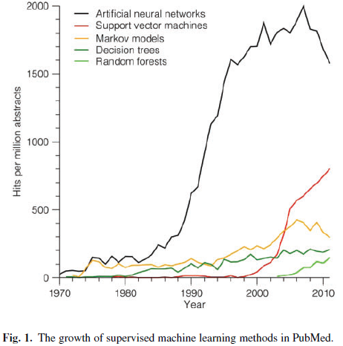
Rise and fall of supervised machine learning techniques, Jensen and Bateman, Bioinformatics 2011
Predominance of ANN has diminished

Slide 3
Why was ANN so popular?
Can be used as a black box
Makes nonlinear modeling easy
Believed to have a biological basis
ANN do not mimic brain function.
ANN belong to the class of non-parametric,
statistical, machine-learning techniques.
This class discusses ANN in the context of
other machine-learning techniques

Slide 4
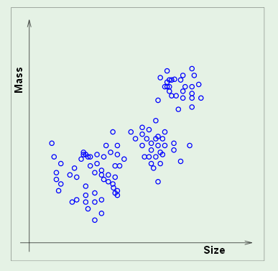
Unsupervised learning: input only – no labels
Coins in a vending machine cluster by size and weight
How many clusters are here?
Would different attributes make clusters more distinct?

Slide 5
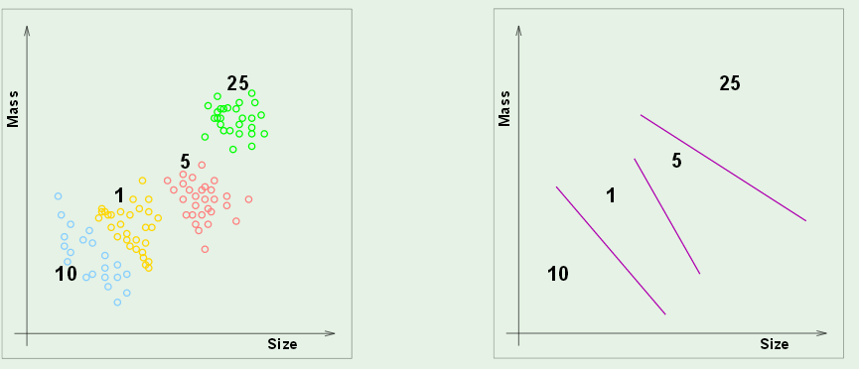
Supervised learning: every example has a label
Labels have enabled a model based on linear discriminants
that will let the vending machine guess coin value without
facial recognition.

Slide 6
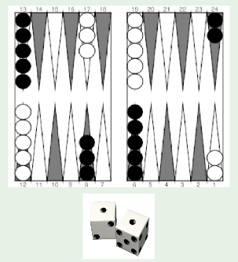
Reinforcement learning: No one correct output
Data: input, graded output
Find relationship between input and high-grade outputs

Slide 7
In-sample error, E_{in}
How well do boundaries match training data?
Out-of-sample error, E_{out}
How often will this system fail if implement in the field?

Slide 8
Quality of data mainly determines success of machine learning
How many data points? How much uncertainty?
We assume each datum is labeled correctly.
Uncertainties is in values of attributes

Slide 9
Choosing the right model
A good model has small in-sample error and generalizes well.
Often a tradeoff between these characteristics is required.

Slide 10
A type of model defines an hypothesis set
Linear discrimants
A particular member of the set is selected by minimizing some
in-sample error.
Error definition varies with problem but usually are local.
(i.e. accumulated from error in each data point)

Slide 11
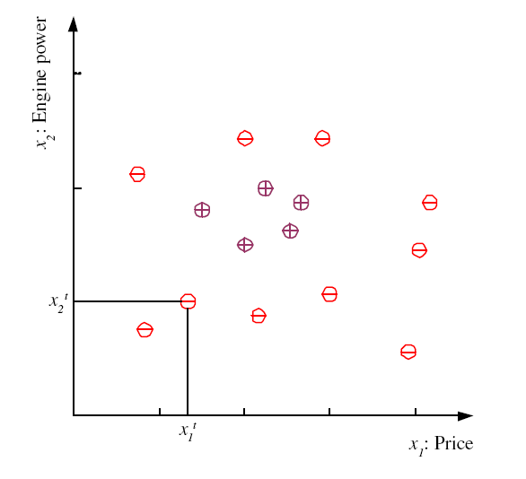
Supervised learning is the focus of this course
Example: Dichotomy based on 2 attributes
examples of family cars
Family-Car is a product line
No uncertainty in the label
Issue is how well do price
and engine size distinguish
a family car.
11
Lecture Notes for E Alpaydın 2010 Introduction to Machine Learning 2e © The MIT Press (V1.0)
Notes:
Χ denotes training set
t is index of training set member
x^{t} is vector of attributes (dimensionality of problem)
r^{t} is label
Label can be either class (classification problem) or real number (regression problem)
This classification problem has only one class (family car) “dichotomizer”
Defined by 2 attributes (price and engine size)
Examples belonging to class are called “positive” and have r = 1
Examples not in class are called “negative” and have r = 0
For some machine learning techniques (SVM) better to assign r = -1 to negative examples
Unsupervised learning: finding attribute space were class members “cluster”

Slide 12
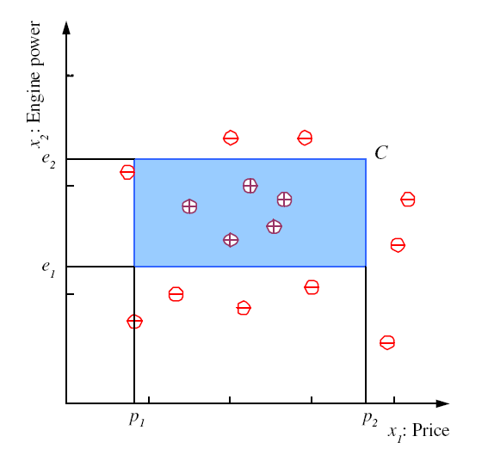
These data suggest family car (class C) uniquely defined by
a range of price and engine power. Assume this is true and
blue rectangle shows the true range of these attributes.
12
Notes:
Clustering of positive examples in this training set allows setting of boundaries in the attribute plane that defines a class
Shape is arbitrary but choice of rectangle with sides parallel to attribute axes facilitates math definition of class

Slide 13
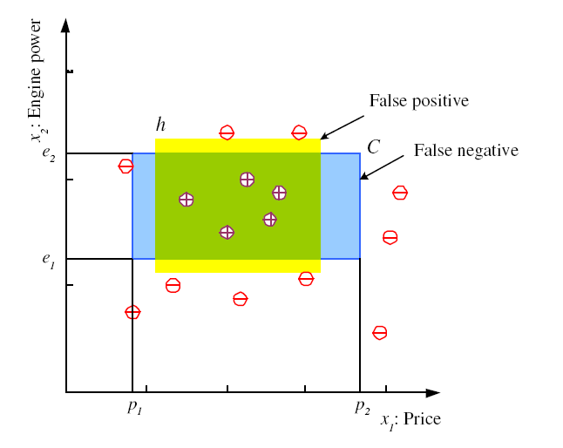
Hypothesis class H: axis aligned rectangles
h = yellow rectangle is a particular member of H
In-sample error on h is defined by
Count misclassifications
13
Notes:
Even with restrictions on shape, an infinite number of family-car classes are consistent with the training data
Boolean function h(x) is a math expression for any hypothesis derived from the training set subject to the constraints on shape
Yellow area denotes one such hypothesis
If the blue area denotes “truth”, then yellow hypothesis exhibits 2 types of error
false positives (in yellow & not in blue)
false negatives (in blue & not in yellow)
E(h|X) defines a total numerical error associated with h(x) for data set X
For the dataset shown, there are infinite number of h with E(h|X) = 0
How do we make an intelligent choice among these h?

Slide 14
Hypothesis class H: axis aligned rectangles
h = yellow rectangle is a particular member of H
For dataset shown, in-sample error on h is zero, but we expect out-of-sample error to be nonzero
h leaves room for false positives and false negatives
14
Notes:
Even with restrictions on shape, an infinite number of family-car classes are consistent with the training data
Boolean function h(x) is a math expression for any hypothesis derived from the training set subject to the constraints on shape
Yellow area denotes one such hypothesis
If the blue area denotes “truth”, then yellow hypothesis exhibits 2 types of error
false positives (in yellow & not in blue)
false negatives (in blue & not in yellow)
E(h|X) defines a total numerical error associated with h(x) for data set X
For the dataset shown, there are infinite number of h with E(h|X) = 0
How do we make an intelligent choice among these h?

Slide 15

Should we expect the negative examples to cluster?
family car

Slide 16
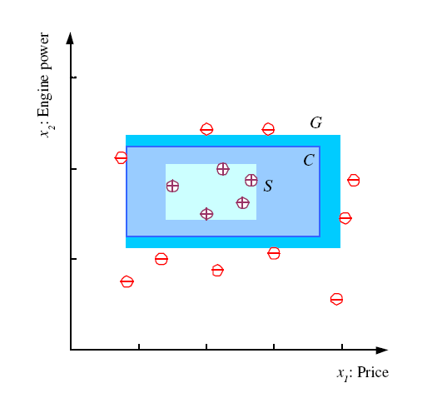
S, G, and the Version Space
most specific hypothesis, S, with no E_{in}
most general hypothesis, G
any h ∈ H,
between S and G is
consistent (no error)
and makes up the
version space
16
Notes:
S = h(x) with min error (zero in this case) and size (“most specific”)
G = h(x) with min error (zero) and max size (“most general”)
Mitchell calls the range of hypothesis classes between S and G the “version” space
Best choice of h(x) in the version space is one that makes most correct predictions (“generalization”)

Slide 17
I have access to a database that associates product line with price, p, and engine power, e, via VIN number. How does the version space change with the following new data: (1) family car (p,e) inside S, (2) family car (p,e) in version space, (3) family car (p,e) outside G, (4) not family (p,e) inside S, (5) not family (p,e) in version space, (6) not family (p,e) outside G
G
S

Slide 18
Margin: distance between boundary of hypothesis
and closest instance in a specified class
S and G hypotheses have
narrow margins; not expected to “generalize”
well.
Even though E_{in} is zero,
we expect E_{out} to be large.
G
S
18
Notes:
Define “margin” of h(x) as the distance between the boundary of h(x) and the instance closest to it
Hypotheses S and G have zero margin

Slide 19
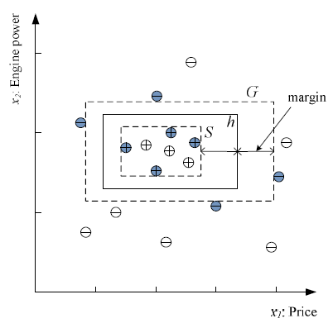
Logic behind “support vector machines”
Choose h in the version space with largest margin to maximize generalization
Data points that determine S and G are shaded. They “support” h with largest margins
Hypothesis with E_{in}=0 and wide margin
19
Notes:
Among h(x) in the version space, the one with largest margin is generally considered to be the best choice for class separation, based on the training set
Data points that determine this choice are (shaded in figure) are said to “support” the optimum h(x)
Other data points could be deleted without effecting our choice of optimum h(x) in the version space

Slide 20
Vapnik Chervonenkis Dimension, d_{VC}
H is a hypothesis set for 2-way classification (dichotomizer)
H(X) is set of dichotomies created by application to H to dataset X with N examples (points in attribute space).
|H(X)|= # of dichotomies that H can generate in X.
N points can be labeled + 1 in 2^{N} ways. |H(X)|< 2^{N}
Let m be largest number of points in X consistent with some member of H. m < N
d_{VC}(H(X)) = m is the “capacity” of H on X
H “shatters” m points in X
k = m+1 is the “break point” of H on X
20

Slide 21
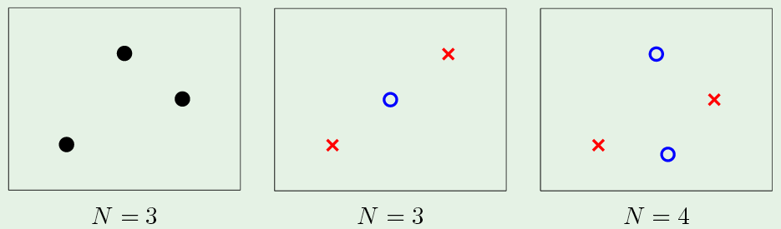
VC dimension of 2D linear dichoromizers
2D datasets can be represented as dots in attribute plane.
Collinear datasets have aligned examples with n > 2.
2D linear dichotomizers can be represented by lines.
3 non-collinear data points are linearly separable regardless of class labels.
21

Slide 22
Break point of 2D linear dichotomizer
Every set of 4 non-collinear points has 2 labeling that are
not linearly separable.
k=4 is the break point for the 2D linear dichotomizer.
d_{vc} = 3
For dD dichotomizer, d_{vc} = d+1.

Slide 23
VC dimension is conservative
VC dimension is based on all
possible ways to label examples
VC ignores the probability
distribution from which dataset
was drawn.
In real-world, examples with
small differences in attributes
usually belong to the same class
Basis of “similarity” classification methods.
K nearest neighbors (KNN) is this type of classifier
family car
23
Lecture Notes for E Alpaydın 2010 Introduction to Machine Learning 2e © The MIT Press (V1.0)
Notes:
For 2D dichotomizes, axis-aligned class boundaries have VC = 4
VC is pessimistic
In real-world, examples with small differences in attributes usually belong to the same class

Slide 25

Margin
Defined as distance between
boundary and closest instance
S and G hypotheses have
narrow margins; not expected to “generalize”
well.
Even though E_{in} is zero,
we expect E_{out} to be large.
Why?
Lecture Notes for E Alpaydın 2010 Introduction to Machine Learning 2e © The MIT Press (V1.0)
25
Notes:
Define “margin” of h(x) as the distance between the boundary of h(x) and the instance closest to it
Hypotheses S and G have zero margin

Slide 26
G
S

Slide 27
What is the VC dimension of the hypothesis class
defined by the union of all axis-aligned rectangles?
Notes:
N because the union could include rectangles small enough to enclose individual data points

Slide 28
Any new data in the version space reduces its size
Positive example increases S, negative example decreases G
G
S

